Slide 1
Revenue Visualization
Submitted To – Submitted By –
Data Analyst Department Praveen Kumar Dwivedi
Photoshooto Krishanu Kundu

Slide 2
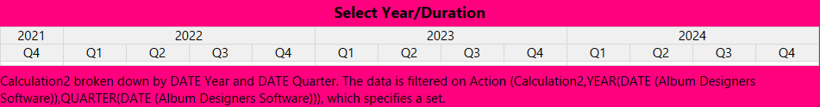
Year and Quarters

Slide 3
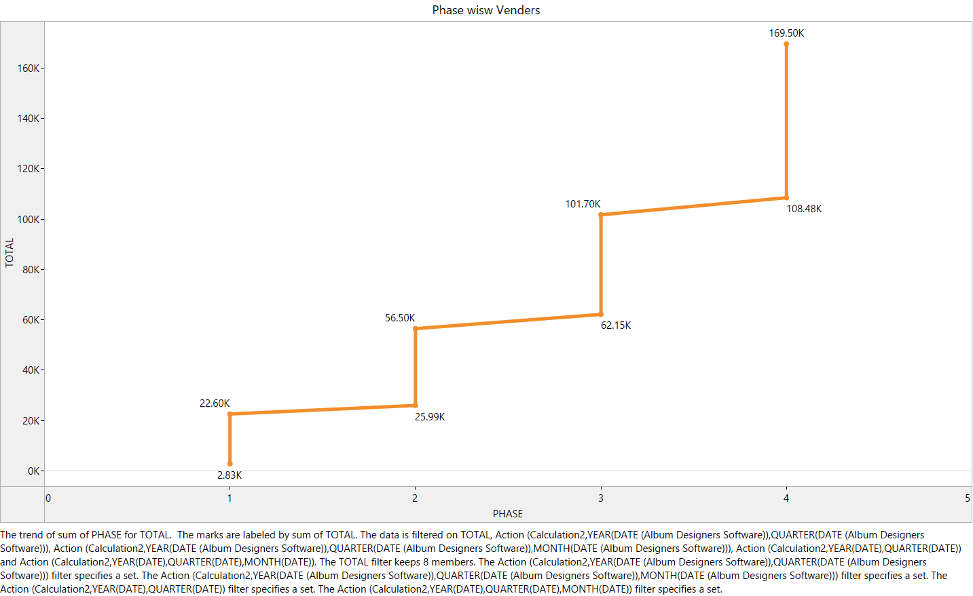
Phase Wise Vendor
The number of vendors has increased over the Phases from 1 to 4.
The sharpest increase in vendor numbers was from Phase 1 to 2 (150%) .

Slide 4
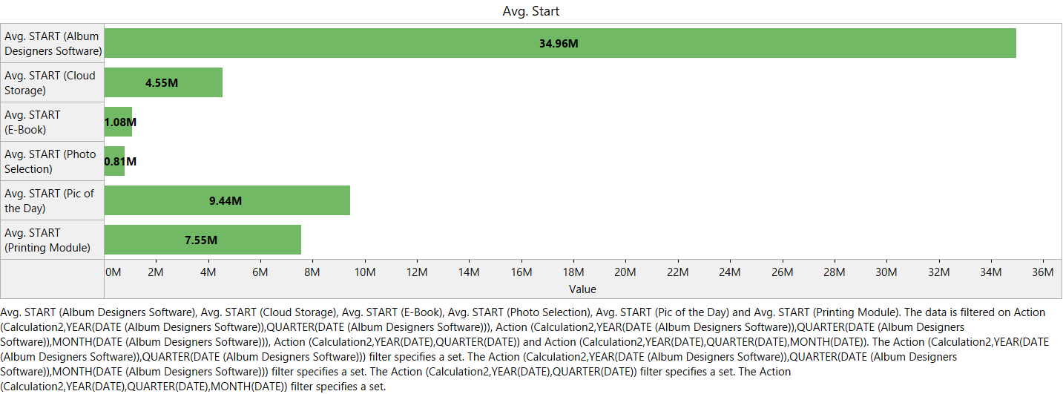
Average Start across Segments
It’s clearly visible that Average Starting is highest for Album Designer Software (34.96 M) and lowest for Photo Selection (0.81 M).

Slide 5
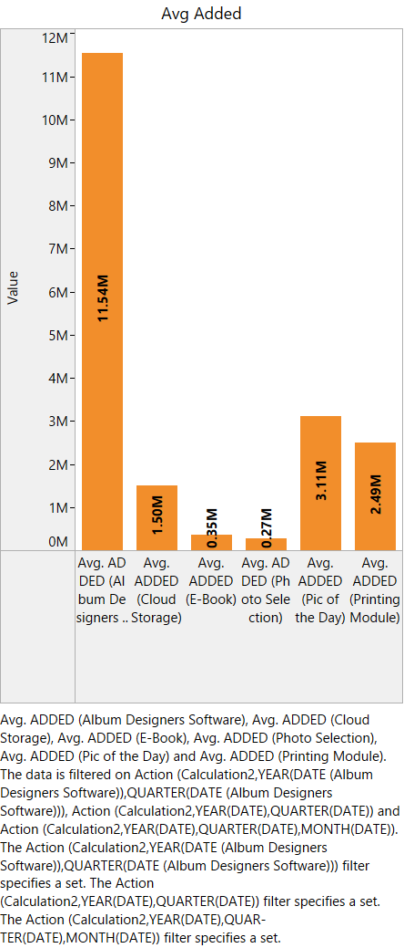
Average Added across segments
Album Designer Software has the highest added Average (11.54 M) and Photo Selection (0.27 M) has the lowest.

Slide 6
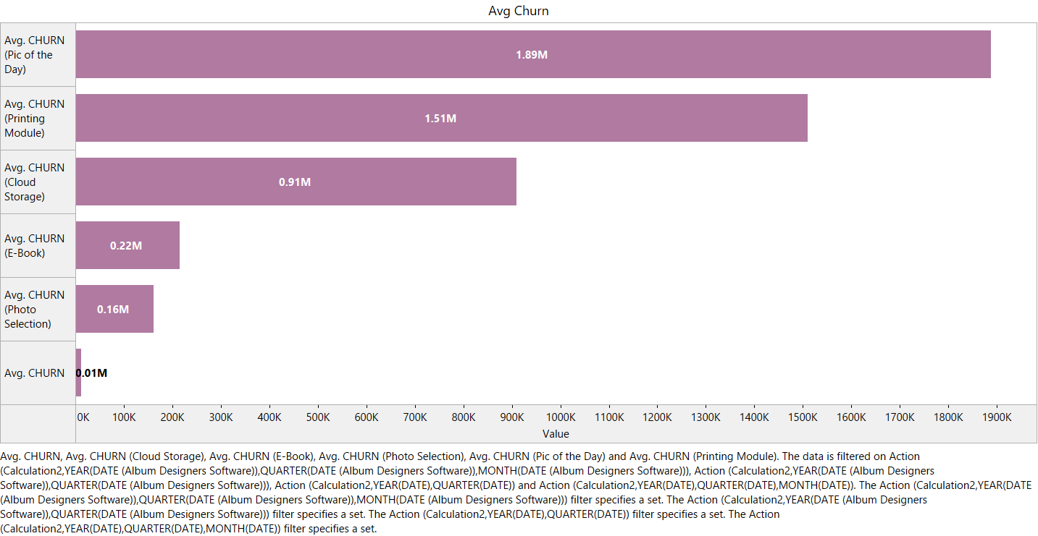
Average Churn across Segments
Average Churn is the highest for Pic of the Day (1.89 M) and lowest for Album Designer Software (0.01 M).

Slide 7
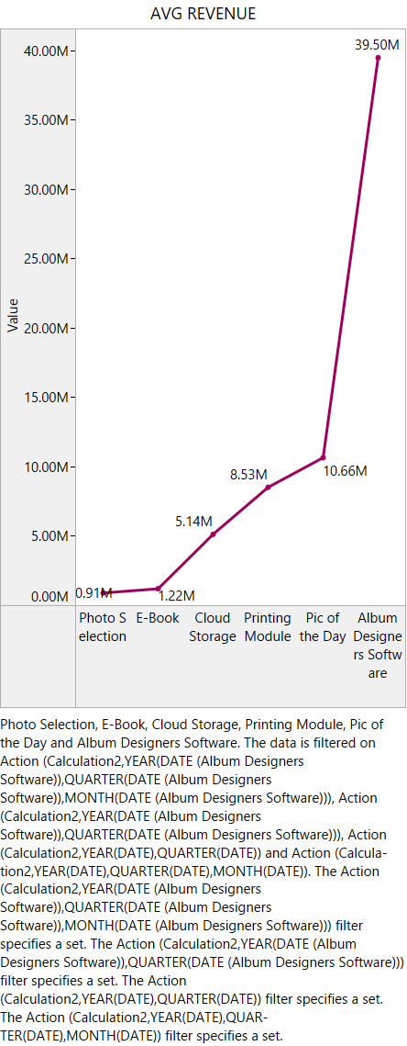
Average Revenue across Segments
Album Designer Software can be the highest Revenue stream (39.50 M) for Photoshooto in the coming years and lowest can be Photo Selection (0.91 M).

Slide 8
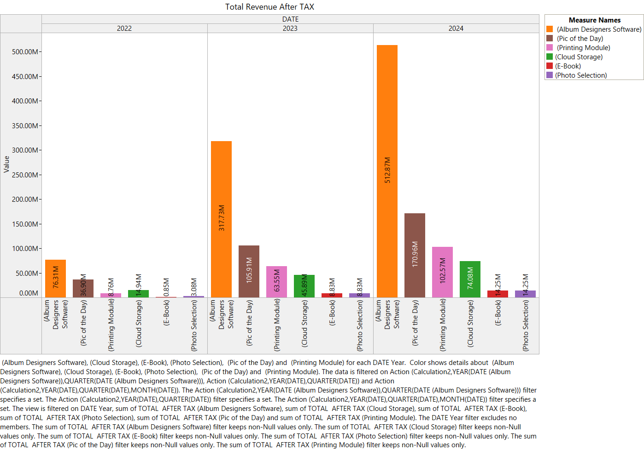
Total Revenue after Tax
Almost every segment has a steady growth whereas Album Designer Software and Pic of the Day can see a exponential growth over the years (2022-2024)

Slide 9
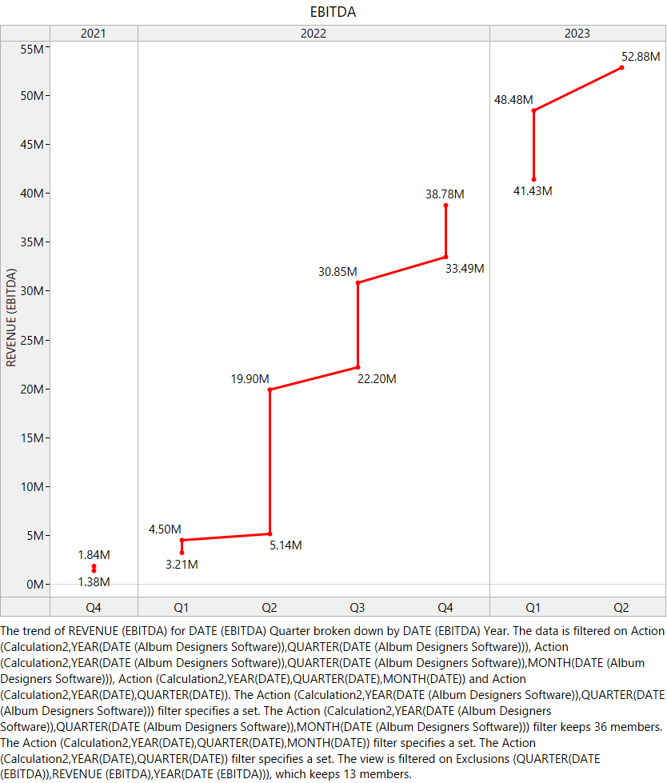
EBITDA
The EBITDA can see a steady growth over the years and different quarters. But, the highest growth has achieved in Q2-Q3, 2022 (55%)

Slide 10
Summary
The Album Designer Software can see the highest Revenue after Tax and Photo Selection can see the lowest.
Both of them can see highest and lowest Start, Added Revenue consecutively for Album Designer Software and Photo Selection. But, churn can be reversible for the both.
According the projection, Photoshooto should focus more on the Album Designing Software and Photo Selection tool can be a less focused area.

Slide 11
